Slide 1
Java Programming
Methods
Unit I – Chapter 7

Slide 2
Overloading Methods
Overloading is defined as the process of:
  Defining two or more methods within the same class that share the same name
  BUT: parameter declarations are different
  This property is called Polymorphism
The following condition is to be satisfied:
  Either number/ type of arguments should be different.
  Return type may be different. But, this should not be the only difference.

Slide 3
class sam
{
void get()
{
System.out.println("Inside get(); No values passed");
}
void get(int a)
{
System.out.println("Inside get(int a); a="+a);
}
void get(double a)
{
System.out.println("Inside get(double a); a="+a);
}
void get(int a,int b)
{
System.out.println("Inside get(int a,int b); a="+a+" b="+b); }
}

Slide 4
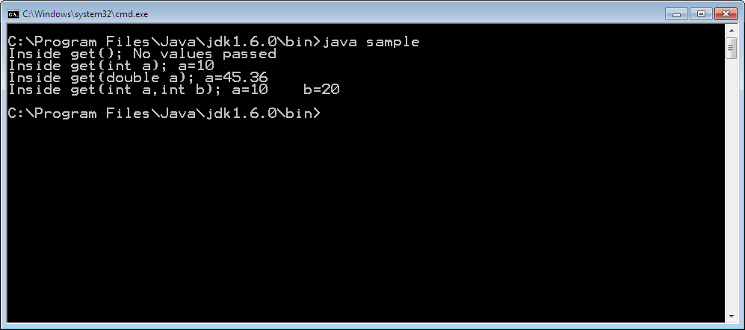
class sample
{
public static void main(String arg[])
{
sam s=new sam();
s.get();
s.get(10);
s.get(45.36);
s.get(10,20);
}
}

Slide 5
class sam
{
void get(int a)
{
System.out.println("Inside get(int a); a="+a);
}
int get(int b)
{
System.out.println("Inside get(double a); b="+b);
return b;
}
}
class sample
{
public static void main(String arg[])
{
sam s=new sam();
s.get(10);
int x=s.get(20);
}
}

Slide 6
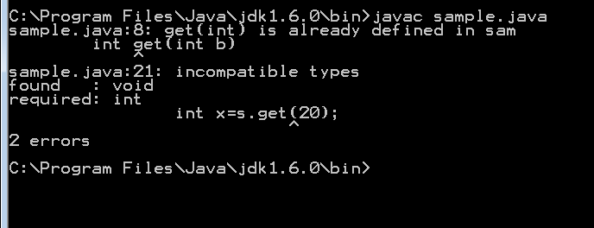
Errors…

Slide 7
class sam
{
void get()
{
System.out.println("Inside get(); No values passed");
}
void get(int a)
{
System.out.println("Inside get(int a); a="+a);
}
void get(double a)
{
System.out.println("Inside get(double a); a="+a);
}
void get(int a,int b)
{
System.out.println("Inside get(int a,int b); a="+a+" b="+b); }
}

Slide 8

class sample
{
public static void main(String arg[])
{
sam s=new sam();
s.get();
s.get(10);
s.get(45.36);
s.get(10,20);
}
}
As no matching arguments are found, Java automatically converts an integer into a double

Slide 9
Advantages of Polymorphism
One interface, multiple methods
Simplicity in remembrance of method names
  Especially in Pre-defined methods
  E.g.., System.out.println(10);
  System.out.println(45.68);
  System.out.println(“Hello”);
  Other e.g.., abs(), sqr();

Slide 10
Overloading Constructors
class sam
{
sam()
{ … }
sam(int a)
{ … }
sam (int a, int b)
{ … }
}
class sample
{
public static void main(String arg[])
{
sam s1=new sam();
sam s2=new sam(10);
sam s3=new sam(10,20);
}
}

Slide 11
Using Objects as Parameters
object1_name . function(object2_name)
class sam
{
int a;
sam(int x)
{ a=x; }
boolean equalto(sam k)
{
if(this.a==k.a)
return true;
else
return false;
}
}

Slide 12
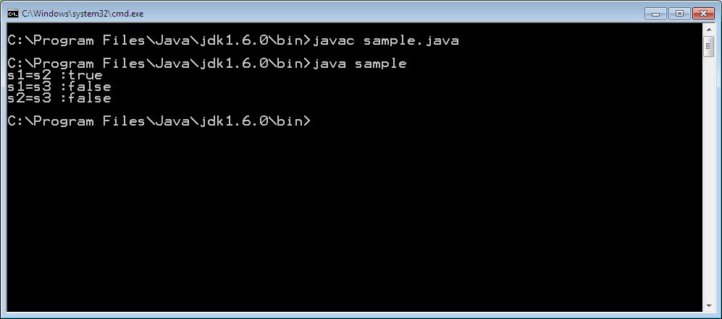
class sample
{
public static void main(String arg[])
{
sam s1=new sam(100);
sam s2=new sam(100);
sam s3=new sam(78);
System.out.println("s1=s2 :"+s1.equalto(s2));
System.out.println("s1=s3 :"+s1.equalto(s3));
System.out.println("s2=s3 :"+s2.equalto(s3));
}
}

Slide 13
Argument Passing
2 ways of passing arguments
  Call-by-value
    Copies the value of an argument into the formal parameter of the subroutine.
    Therefore, changes made to the parameter of the subroutine have no effect on the argument
  Call-by-reference
    a reference to an argument (not the value of the argument) is passed to the parameter.
    changes made to the parameter will affect the argument used to call the subroutine

Slide 14






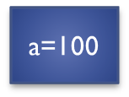

class sam
{
void change(int i, int j)
{
i=i+10;
j=j+20;
}
}
class sample
{
public static void main(String arg[])
{
sam s=new sam();
int a=100, b=200;
System.out.println("Before calling change() a="+a+" b="+b);
s.change(a,b);
System.out.println("After calling change() a="+a+" b="+b);
}
}

Slide 15
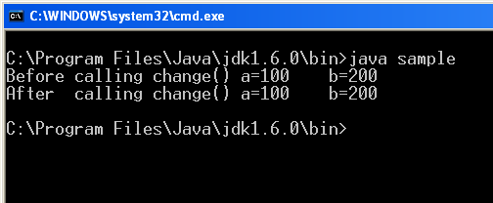

Slide 16
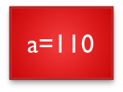
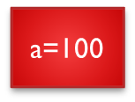
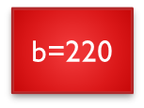
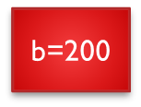
class sam
{
int a, b;
sam(int a, int b)
{ this.a=a; this.b=b; }
void change(sam s)
{
a=s.a+10;
b=s.b+20;
} }
class sample
{
public static void main(String arg[])
{
int a=100, b=200;
sam s=new sam(a,b);
System.out.println("Before calling change() a="+s.a+" b="+s.b);
s.change(s);
System.out.println("After calling change() a="+s.a+" b="+s.b);
} }
“s”
(sam
Object)

Slide 17
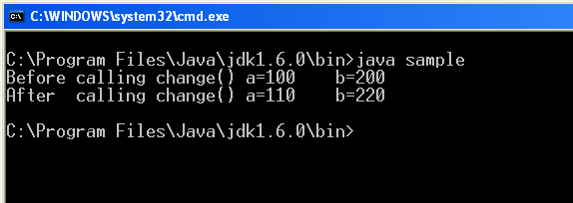

Slide 18
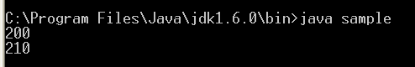
Returning Objects
class sam
{
int a;
sam(int i)
{
a=i;
}
sam change(sam s, int x)
{
sam temp=new sam(10);
temp.a=a+x;
return temp;
}
}
class sample
{
public static void main(String arg[])
{
sam s1=new sam(200);
sam s2=s1.change(s1,10);
System.out.println(s1.a);
System.out.println(s2.a);
}
}

Slide 19
Recursion
Recursion is the process of defining something in terms of itself
A method that calls itself is said to be recursive
E.g.., computation of the factorial of a number
        int fact(int n)
        {
        int result;
        if(n==1) return 1;
        result = fact(n-1) * n;
        return result;
        }

Slide 20
Access Control
Protect (Encapsulate) & Prevent misuse
Java’s access modifiers are public, private, and protected

Slide 21
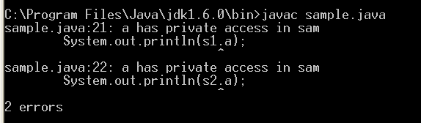
Access Control
class sam
{
private int a;
sam(int i)
{
a=i;
}
sam change(sam s, int x)
{
sam temp=new sam(10);
temp.a=a+x;
return temp;
}
}
class sample
{
public static void main(String arg[])
{
sam s1=new sam(200);
sam s2=s1.change(s1,10);
System.out.println(s1.a);
System.out.println(s2.a);
}
}

Slide 22
Understanding “Static”
It is possible to create a member that can be used by itself, without reference to a specific instance (object)
When a member is declared static, it can be accessed before any objects of its class are created, and without reference to any object
Static Method has Restrictions:
  They can only directly call other static methods
  They can only directly access static data
  They cannot refer to “this” or “super” in any way

Slide 23
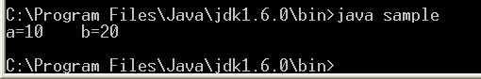
class sam
{
static int a=10;
static int b=20;
static void put()
{
System.out.println("a="+a+" b="+b);
}
}
class sample
{
public static void main(String arg[])
{
sam.put();
}
}

Slide 24

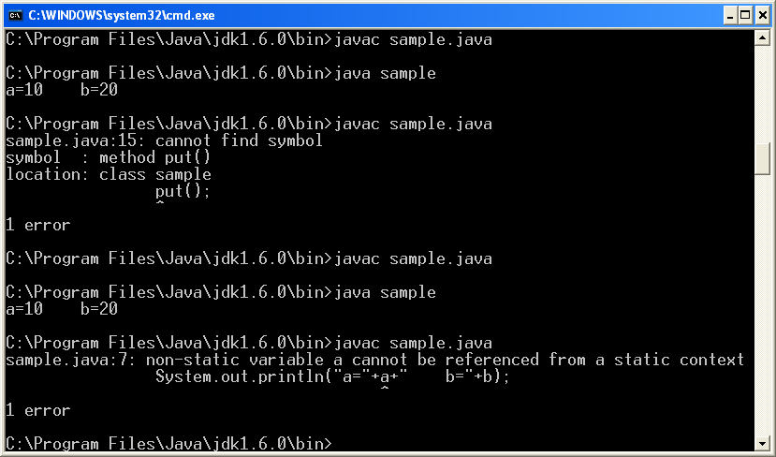
class sam
{
int a=10;
static int b=20;
static void put()
{
System.out.println("a="+a+" b="+b);
}
}
class sample
{
public static void main(String arg[])
{
sam.put();
}
}
static
Accessing Member variables:
System.out.println(sam.a+ “….” + sam.b);

Slide 25
Introducing final
Prevents a variable contents from being modified → like constant
final <data-type> <variable> = <value>
2 ways to declare value for “final” variable
  Give it a value when it is declared
  E.g.., final int a=10;
  assign it a value within a constructor
“final” can also be applied to methods (next chapter)

Slide 26
Arrays Revisited
Arrays are implemented as “object” in Java
Length is an attribute inside “array” object
  Used to find the number of elements that an array can hold.
  Accessed as <array_name> . length
  Syntax: int a[] = new int[10];
  System.out.println(a.length);

Slide 27
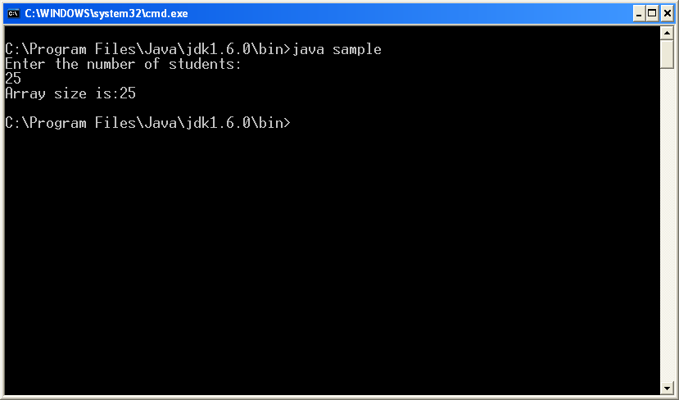
import java.io.*;
class sample
{
public static void main(String arg[]) throws Exception
{
int studs[];
System.out.println("Enter the number of students:");
DataInputStream inp=new DataInputStream(System.in);
int n;
n=Integer.parseInt(inp.readLine());
studs=new int[n];
System.out.println("Array size is:"+studs.length);
}
}

Slide 28
Nested and Inner Classes
Nested Class : a class within another class
class A → Enclosing class (Outer class)
{
<class A variables and Methods>
class B → Nested Class (inner class)
{
<class B variables and Methods>
}
}

Slide 29
Properties of Nested Class
A nested class has access to the members, including private members, of the class in which it is nested.
The enclosing class does not have access to the members of the nested class
  Nested class (Inner class) is a member of enclosing class
2 types of nested class:
  Static → has “static” modifier
  Non-static

Slide 30
class outer
{
int x=10;
void out_display()
{
System.out.println("Value of x:"+x);
}
class inner
{
int y=20;
void in_display()
{
System.out.println("Value of y:"+y);
}
}
}
class sample
{
public static void main(String arg[]) throws Exception
{
outer out=new outer();
out.out_display();
inner inn=new inner();
inn.in_display();
} }

Slide 31
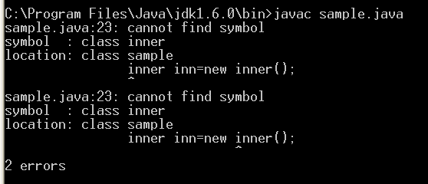

Slide 32
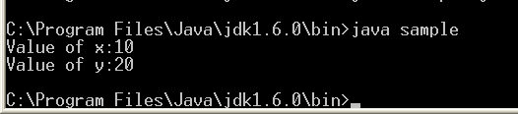
class outer
{
int x=10;
void out_display()
{
System.out.println("Value of x:"+x);
inner inn=new inner();
inn.in_display();
}
class inner
{
int y=20;
void in_display()
{
System.out.println("Value of y:“+y);
}
}
}
class sample
{
public static void main(String arg[]) throws Exception
{
outer out=new outer();
out.out_display();
} }

Slide 33
Varargs: Variable-Length Arguments
A mechanism where, a method takes variable number of arguments
  Such method is called as variable-arity method, or simply a varargs method
  E.g.., System.out.println(“Hello”);
  System.out.println(“a:”+a+ “b:” +b);
Two ways of declaration:
  void method(int a[])
  void method(int … a) → where “…” is period operator

Slide 34
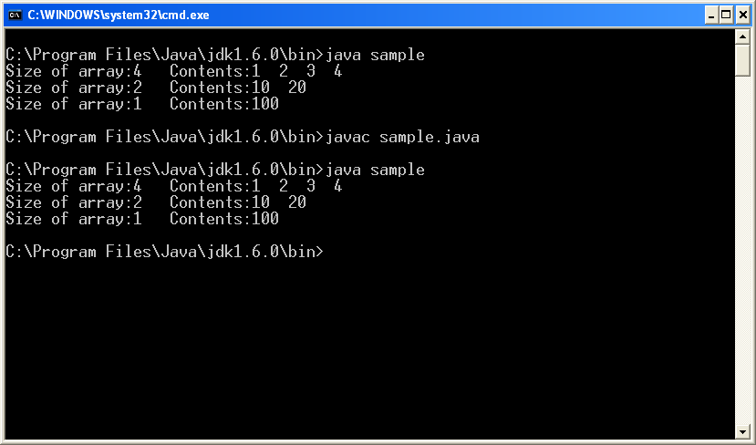
class sam
{
void disp(int v[])
{
System.out.print("Size of array:"+v.length);
System.out.print(" Contents:");
for(int i=0;i<v.length;i++)
System.out.print(v[i]+" ");
System.out.println("");
}
}
class sample
{
public static void main(String arg[]) throws Exception
{
int a1[]={1,2,3,4};
int a2[]={10,20};
int a3[]={100};
sam s=new sam();
s.disp(a1);
s.disp(a2);
s.disp(a3);
}
}

Slide 35
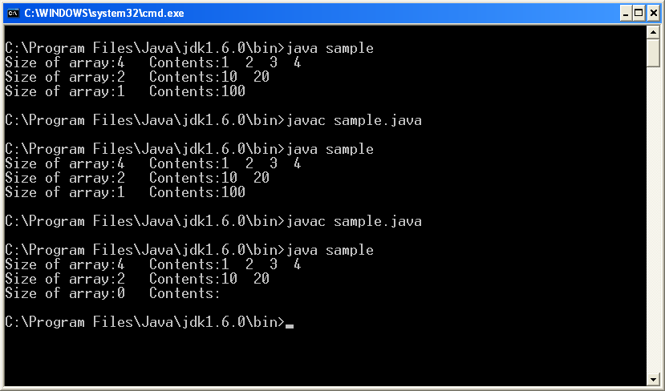
class sam
{
void disp(int … v)
{
System.out.print("Size of array:"+v.length);
System.out.print(" Contents:");
for(int i=0;i<v.length;i++)
System.out.print(v[i]+" ");
System.out.println("");
}
}
class sample
{
public static void main(String arg[]) throws Exception
{
int a1[]={1,2,3,4};
int a2[]={10,20};
int a3[]={100};
sam s=new sam();
s.disp(a1);
s.disp(a2);
s.disp();
}
}

Slide 36
Overloading “Vararg” methods
void disp(int … v)
{
…
}
void disp(boolen … x)
{
…
}
void disp(String aa, int … v)
{
…
}
int v[]=new int[10];
disp(v)
boolean x[]=new boolean[3];
disp(x)
String aa=“hello”;
disp(aa, v)

Slide 37
Thank You

